Slide 1

Protecting our communities together
West Forum
Date: 2^{7th} November 2014

Slide 2
Data Protection notice
When discussing members of the public, all agencies
and individuals will agree to respect their
confidentiality. The disclosure of information outside
this meeting, should not occur unless there is a legal
basis for a disclosure.
Community Priorities
Warwickshire Police is obliged to protect communities from harm in line with the ‘Police Priorities’
This may mean in exceptional circumstances SNT officers may be required to work on other policing priorities.
If this happens there will be a need to re-negotiate priorities. This will be done in liaison with the Chair of the panel

Slide 3
SNT Priorities
    Parking outside Hurley Primary School – Heanley Lane/Knowle Hill, Hurley
    Parking on Bromage Avenue, outside Kingsbury Primary School

Slide 4

    Parking outside Hurley
    Primary School
13 targeted patrols and engagement with school staff
In total, 7 motorists were spoken to about minor parking issues. No motorists have been issued with Traffic Offence Reports in this period.
From our patrols, there has been a notable decrease in the number of offending vehicles at this location and we genuinely feel that a large proportion of the parents have taken on board the advice given to them by officers.

Slide 5
Parking outside Kingsbury Primary School, Bromage Avenue
13 targeted patrols carried out at the location and engagement with School Headteacher and local residents carried out.
In total 9 motorists have been advised and given verbal warnings about their parking, 1 motorist was issued with a Traffic Offence Report for obstruction offences. Several groups of parents have been advised on basic rules of the road about where you can and cannot park.
Assembly with the children at the school conducted by PCSO Beale to highlight local issues, school parking being one of the main focuses.

Slide 6
Other Work
On 15th October PC Newton and PCSO Owen attended a crime prevention event at Nether Whitacre Village Hall whereby local residents were able to engage with the local SNT and gain access to invaluable crime prevention tools and information.
On 19th October, PC Hood and PCSO Owen issued 4 Section 59 warnings to riders of off road motorbikes seen in the area of Kingsbury Link. Great progress in dealing with this difficult issue.
Officers in the SNT are currently undergoing a massive project to update and reinvigorate our relationship with NHW co-ordinators that give their time to help us in serving the community. We hope as a result of the hard work, this will lead to better communication both to and from the police, in order to better inform the public and enlist their help in protecting the communities they live in.
6 riders of off road motorbikes were issued with S.59 warnings by our off road policing team on 16th November. The team were requested by the local SNT as they have the specialist skills and equipment to deal with these offenders.

Slide 7
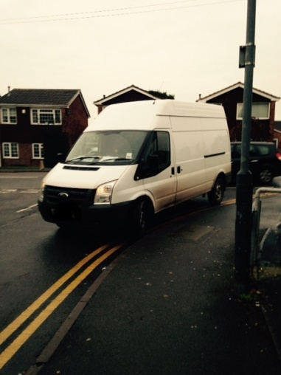
Other Work
On 23rd November, officers from the off road policing unit were again asked to patrol our area. As a result a further 6 S.59 warnings were issued to offenders.
The pictured vehicle was seen
on 11/11/14 parked on the junction
of Barlow Court and Tamworth Rd –
dangerous and obstructive – driver
issued with traffic offence report
Finally, we must advise you all that we have said a fond farewell to Sgt. Roger Fildes who has just worked his last day for Warwickshire Police after 30 years service. Sgt. Mitch Oakley will take on the role of North Warwickshire SNT Sergeant and brings a wealth of skills and knowledge to the role.

Slide 8
North Warwickshire Community Safety Partnership
Reducing Rural Crime Project – Warwickshire Rural Watch scheme set up
www.warwickshireruralwatch.co.uk
Rural Crime Co-ordinator – Carol Cotterill
Providing wide range of crime prevention advice and security products
Attending local events providing property marking and advice
Future item for Area Forum West ?

Slide 9
North Warwickshire Community Safety Partnership
Mobile cctv camera deployed at Railway Station car park Water Orton
Plans to convert and deploy mobile cameras in partnership with the Co-op in Wood End and Kingsbury
On going monitoring of hot spot locations for motorbike nuisance

Slide 10

Christmas Crime Prevention Campaign

Slide 11
Thank you for your time.
Please contact the team should you have any queries or concerns.
Tel: 02476 483554
Email: nww.snt@warwickshire.police.uk
Web: www.safer-neighbourhoods.co.uk/nww

