Slide 1
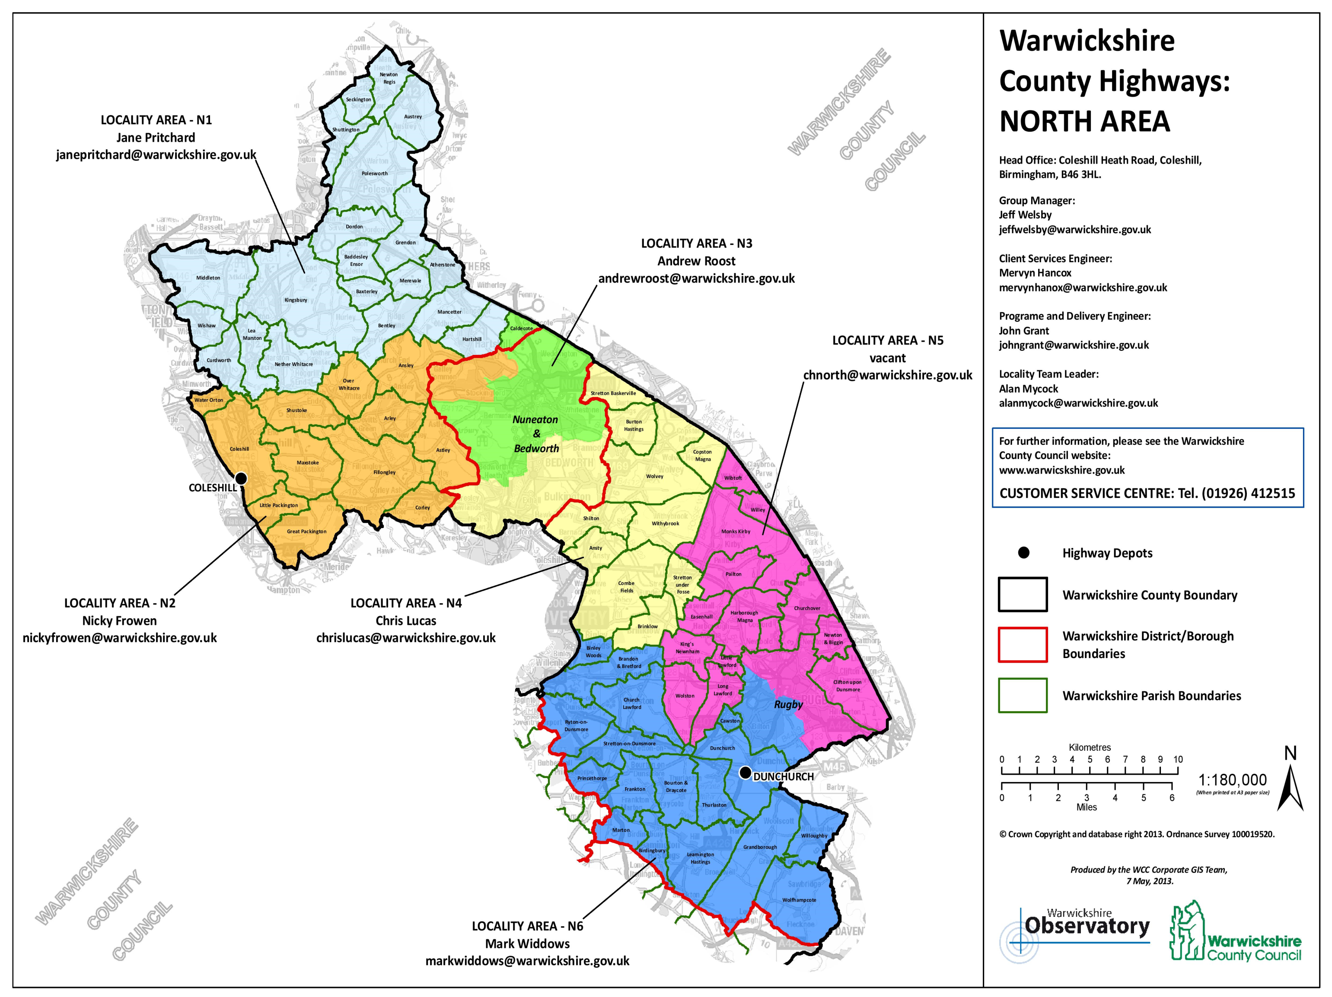
Warwickshire County Highways:
NORTH AREA
Head Office: Coleshill Heath Road, Coleshill, Birmingham, B463HL
Group Manager:
Jeff Welsby
jeffwelsby@warwickshire.gov.uk
Client Services Manager:
Bryn Patefield
brynpatefield@warwickshire.gov.uk
Client Team Leader (N1,N2,N3 Green):
Benjamin Hill
benjaminhill@warwickshire.gov.uk
Client Team leader(N3 Yellow, N4,N5,N6):
Daniel Perkins
danielperkins@warwickshire.gov.uk
Programme & Delivery Engineer
John Grant
johngrant@warwickshire.gov.uk
LOCALITY AREA – N1
Jane Pritchard
janepritchard@warwickshire.gov.uk
LOCALITY AREA – N3
Andrew Roost
andrewroost@warwickshire.gov.uk
LOCALITY AREA – N5
Craig Thompson
craigpthompson@warwickshire.gov.uk
For further information, please see the Warwickshire County Council website:
www.warwickshire.gov.uk
Customer Service Centre: Tel. (01926) 412515
Highway depots
Warwickshire County Boundary
Warwickshire District/Borough Boundaries
Warwickshire Parish Boundaries
LOCALITY AREA – N2
Andy Keating
andykeating@warwickshire.gov.uk
LOCALITY AREA – N4
Nabil Miah
nabilmiah@warwickshire.gov.uk
LOCALITY AREA – N6
Richard Haycock
richardhaycock@warwickshire.gov.uk

Slide 2
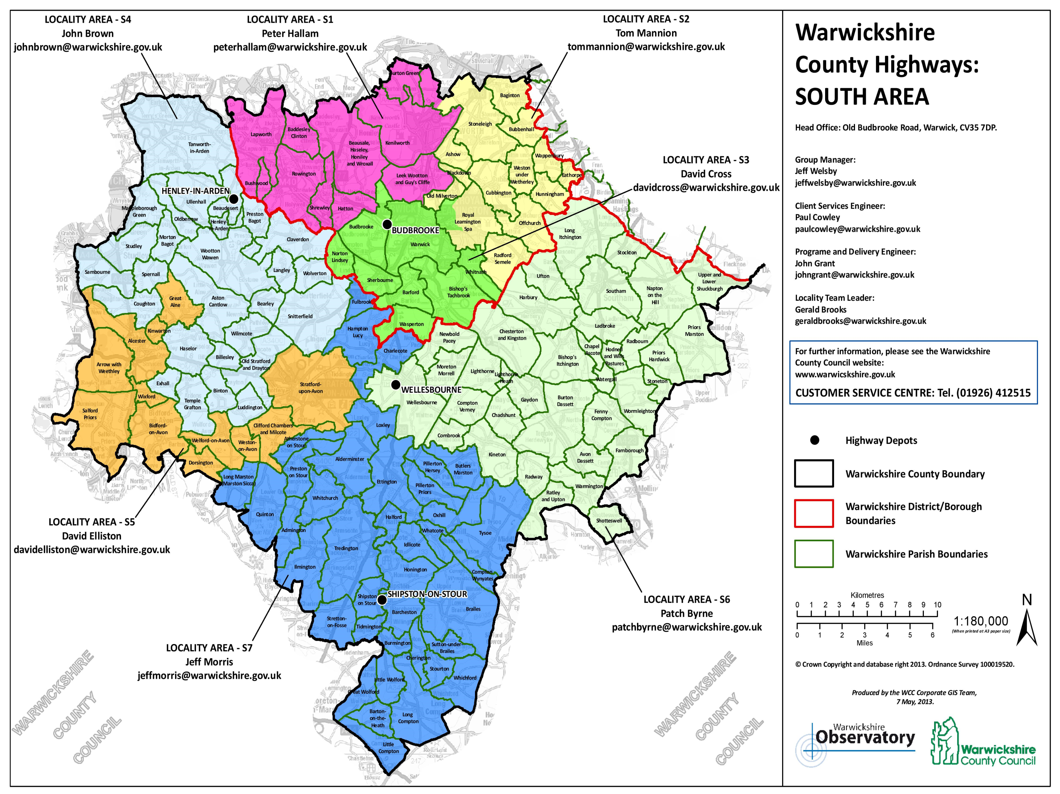
LOCALITY AREA – S4
John Brown
johnbrown@warwickshire.gov.uk
LOCALITY AREA – S1
Peter Hallam
peterhallam@warwickshire.gov.uk
LOCALITY AREA – S2
David Elliston
davidelliston@warwickshire.gov.uk
Warwickshire County Highways:
SOUTH AREA
Head Office: Old Budbrooke Road, Warwick, CV357DP
Group Manager:
Jeff Welsby
jeffwelsby@warwickshire.gov.uk
Client Services Manager:
Bryn Patefield
brynpatefield@warwickshire.gov.uk
Client Team Leader (S1,S2,S3):
Gerald Brooks
geraldbrooks@warwickshire.gov.uk
Client Team leader(S4,S5,S6,S7):
Jeff Morris
jeffmorris@warwickshire.gov.uk
Programme & Delivery Engineer
John Grant
johngrant@warwickshire.gov.uk
LOCALITY AREA – S3
David Cross
davidcross@warwickshire.gov.uk
For further information, please see the Warwickshire County Council website:
www.warwickshire.gov.uk
Customer Service Centre: Tel. (01926) 412515
LOCALITY AREA – S5
Alan Caldwell-Jones
Alancaldwell-jones@warwickshire.
gov.uk
LOCALITY AREA – S6
Patch Byrne
patchbyrne@warwickshire.gov.uk
LOCALITY AREA – S7
Michael Rogers
michaelrogers@warwickshire.gov.uk

