Slide 1
County Highways
Community Forum Presentation
Jeff Morris
Client Team Leader
SDC Area

Slide 2
Overview
Who we are and the areas we cover
What is our responsibility and what is not
Getting the work done
Questions

Slide 3
County Highways
Who we are and the areas we cover
SDC Area – approx 400 sq miles
Split into 4 Locality Officer Areas

Slide 4
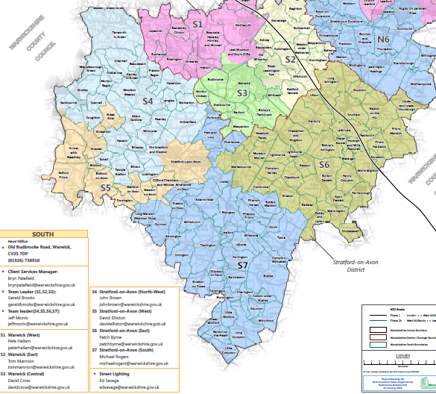

Slide 5
County Highways
Client Team
Delivery Team
Streetlighting Team
Admin Team
Policy Team
Insurance and Cost Recovery

Slide 6
Highways Act 1980 – Statutory Duties
Licensing and other applications e.g vehicle accesses
Carriageways & Footways
Signs and Lines
Drainage
Trees
Verge Maintenance
Structural works
Traffic Projects
New Developments – maintenance design
Winter Maintenance
Legal Enforcement e.g Encroachment
Public Face of WCC County Highways

Slide 7
County Highways
Getting the job done….
Term Maintenance contract with Balfour Beatty
The Contract
Traffic Management and Permits
Timescales

Slide 8
County Highways
Any other questions?
Thank you

Slide 9
County Highways
Community Forum Presentation
Jeff Morris
Client Team Leader
SDC Area

