Slide 1
Ordinary Watercourse Maintenance
Mark Banning
Assistant Drainage Engineer, Warwickshire County Council
Thursday 14th June 2018

Slide 2
Roles and Responsibilities
Lead Local Flood Authorities have an oversight role for Ordinary Watercourses just as the EA do for Main Rivers.
Responsibility for maintenance lies with the riparian landowner.
What is an ordinary watercourse and who is the riparian landowner?

Slide 3
Ordinary Watercourse Definition
Land Drainage Act 1991: “ordinary watercourse” means a watercourse that does not form part of a main river
“watercourse” includes all rivers and streams and all ditches, drains, cuts, culverts, dikes, sluices, sewers (other than public sewers within the meaning of the Water Industry Act 1991) and passages, through which water flows.

Slide 4
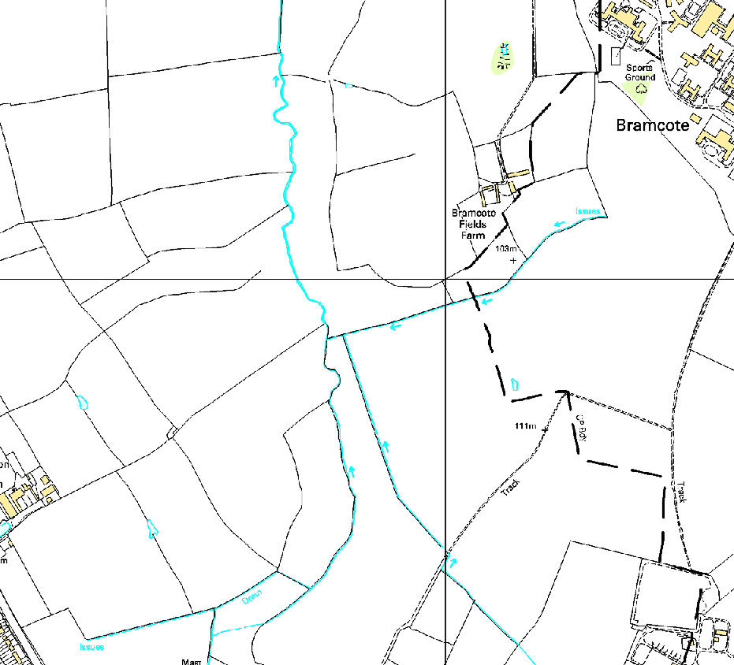
Watercourse or Ditch?
Watercourse
Ditch

Slide 5
Watercourse maintenance responsibility
Midpoint of watercourse
Landowner 1 boundary
Landowner 2 boundary
Landowner 1 maintenance responsibility
Landowner 2 maintenance responsibility

Slide 6
Ditch maintenance responsibility
Real legal boundary
(unless title deeds say otherwise)
Boundary on OS map
Landowner 1 maintenance responsibility
Landowner 2 maintenance responsibility
Common Law ‘Hedge and Ditch Rule’

Slide 7
Ditch maintenance responsibility
Real legal boundary
(unless title deeds say otherwise)
Boundary on OS map
Landowner 1 maintenance responsibility
Highways Authority maintenance responsibility
Common Law ‘Hedge and Ditch Rule’ – roadside ditches

Slide 8
The hedge and ditch rule is a rebuttable legal presumption that where there is a hedge and ditch running along the boundary of a parcel of land then the boundary lays along the farthest edge of the ditch from the hedge. The presumption is that the owner of the land dug the ditch along the edge of their boundary and then piled up the soil along their land, after which a hedge was planted. This presumption can be rebutted, for example, if the ditch can be shown to have been dug whilst the land was in common ownership. Other examples of rebuttal were seen in the case of Steward v Gallop [2010] EWCA Civ 823 where the hedge ran only along part of the relevant boundary and the hedge predated the ditch. Tees Law 2018

Slide 9
You have the responsibility to pass on flow without obstruction, pollution or diversion affecting the rights of others..
You must accept flood flows through your land, even if these are caused by inadequate capacity downstream. There is no duty in common law for a landowner to improve the drainage capacity of a watercourse.
You must maintain the bed and banks of the watercourse, and also the trees and shrubs growing on the banks. You must also clear any debris, even if it did not originate from your land. This debris may be natural or man-made, and includes litter and animal carcasses.

Slide 10
You must keep the bed and banks clear of any matter that could cause an obstruction, either on your land or downstream if it is washed away.
You must keep any structures that you own clear of debris. These structures include culverts, trash screens, weirs and mill gates.

Slide 11
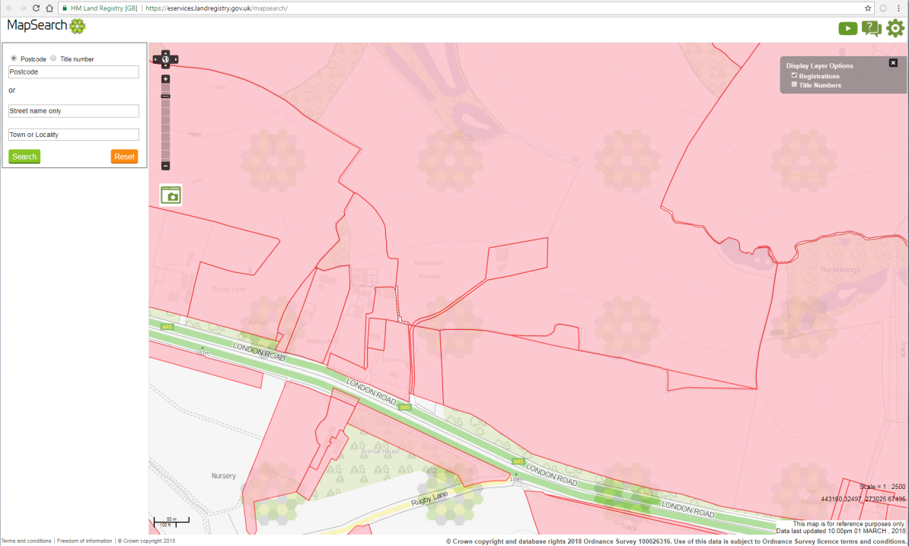
Finding out who owns the land
Our intention is to develop templates
which we can share with Parish
Council, Town Councils and other
community groups to ensure a
consistent approach across the
county.

Slide 12
Making it work…
Land drainage law is complex and identifying ownership is not always simple
Parish and Town Councils and Flood Groups can help solve local issues at a local level
We enforce on a prioritised basis
‘Living on the Edge’ available on the EA website and a link from our website
‘Farming and the Public Highway’ available on WCC website

