Slide 1
Naming the Nuneaton – Leamington Railway Line

Slide 2
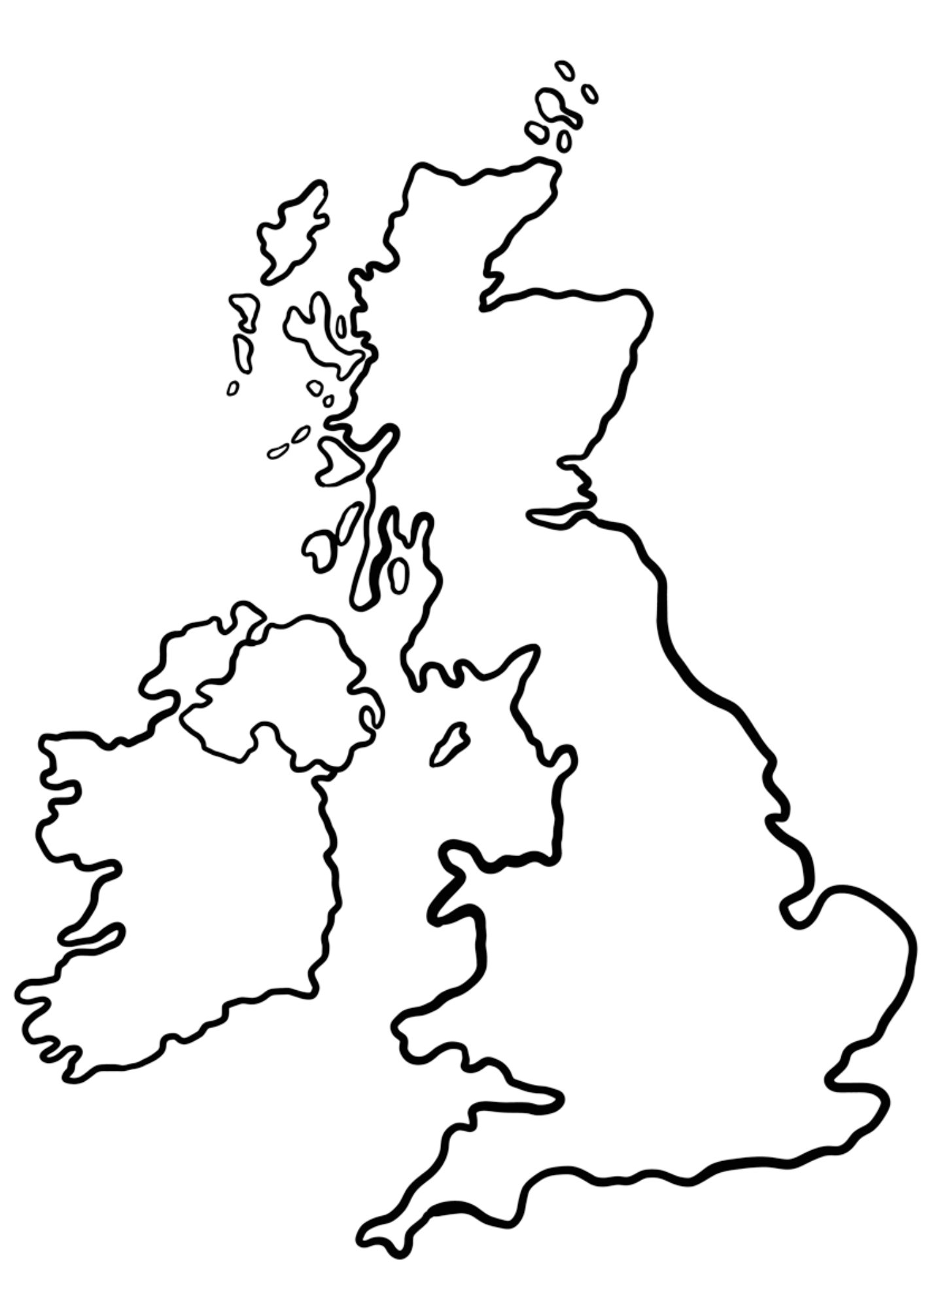
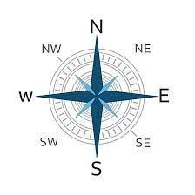
Can you mark on the map the places you’ve travelled to on a train?
Where do we live?
Notes:
Teacher notes:
Whole Class Discussion.
Who’s travelled by train?
Where are some of the places you’ve travelled? Why did you go there?
Where do we live?
Support – Teacher can plot the points on the map
Scaffold – Key locations such as Birmingham, London, Edinburgh can be marked onto the map prior to the lesson and teacher can use these to help students plot locations.
Stretch – Ask students to describe where the places they’ve travelled are using the compass directions.

Slide 3
What’s so great about the area around Bermuda Park Station?
Things to do and see near Bermuda Park Station:
Notes:
Teacher Prompts:
In pairs, tell each other why Bermuda Park is special to us. Think about places you’ve been with friends and family, activities you have done, places/buildings/outdoor spaces you like.
Record students’ answers in box.
Why do you think people may want to come and visit this area?

Slide 4
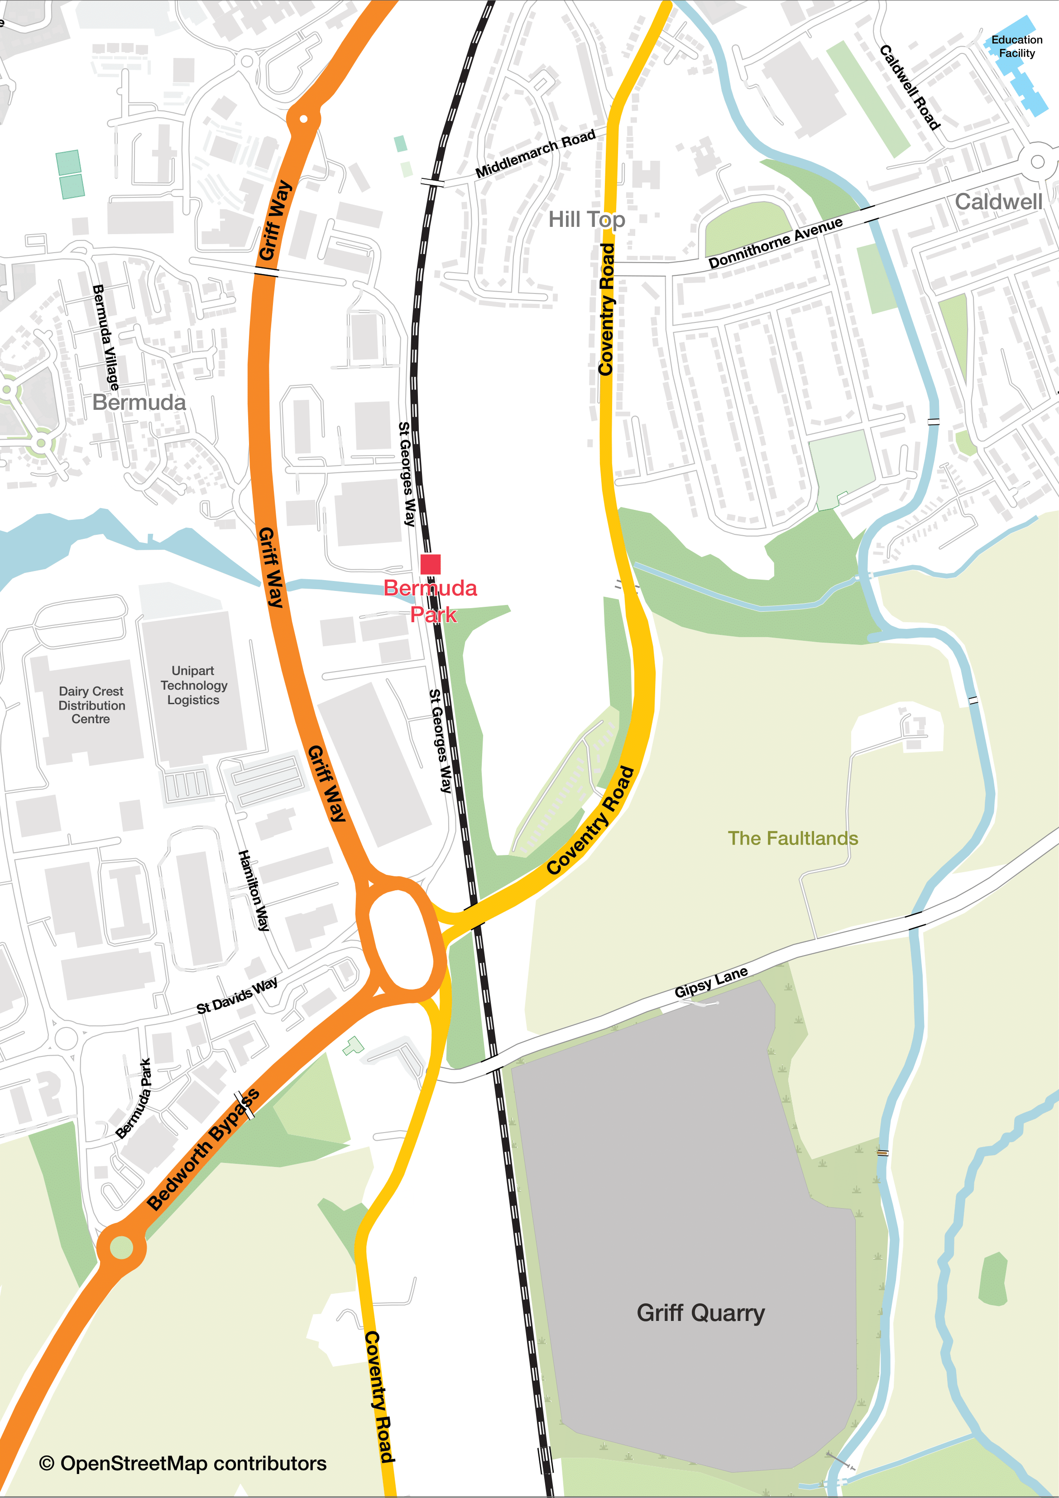
Bermuda Park and Pond
Coventry Canal
Phoenix Community Centre
George Eliot Hospital
Notes:
Teacher Prompts:
In pairs or small groups, look at the large map of Bermuda Park.
Can you spot where the railway station is?
As a class, plot where the school is on the map.
In your groups can you place the key attractions around the map? Answers on the next slide.
Support – Groups can work with an adult for this activity
Scaffold – Use the version of the map where students can match place names with pictures
Stretch – Use the blank map (just delete the names of the attractions on the side) and ask students to map the places just using the list of attractions

Slide 5
George Eliot Hospital
Phoenix Community Centre
Bermuda Park and Pond
Coventry Canal

Slide 6
Why travel by rail?
Fewer cars in the town centre - 1 train can take up to 500 cars off the road.
Reduces carbon emissions – in 2019, transport accounted for 27% of the UKs carbon emissions. Rail only accounts for a tiny proportion of that, 1%, despite accounting for 10% of total distance travelled. Road transport accounts for 91% of emissions, including 55% from cars and taxis.
Combine train travel with sustainable travel modes such as cycling and walking, for a healthier, greener lifestyle.
Notes:
Teacher prompts:
Remind students of the competition to name the railway line
Why do we want to encourage people to use the railways to visit Bermuda Park?
Click to reveal the answers

Slide 7
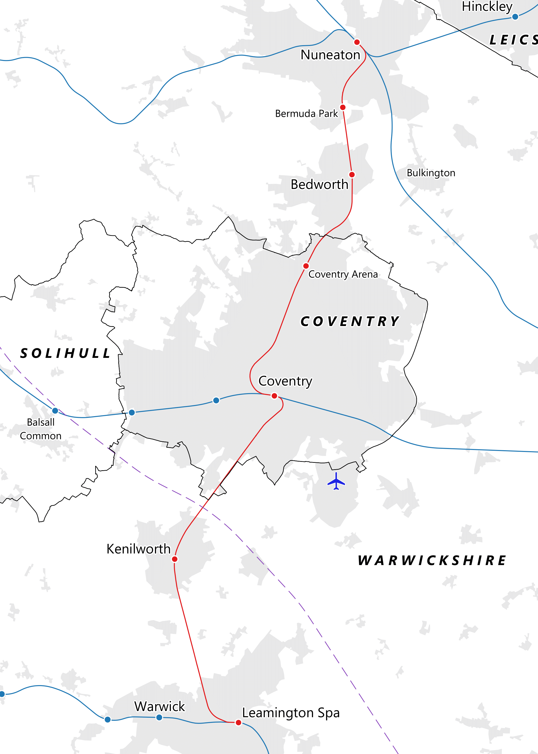
The Nuneaton – Leamington Line
Notes:
Look at the map of the Nuneaton - Leamington line as a class.
Has anyone used the train to visit any places or attractions along the line? Answers can be recorded on the board to help with group activity.

Slide 8
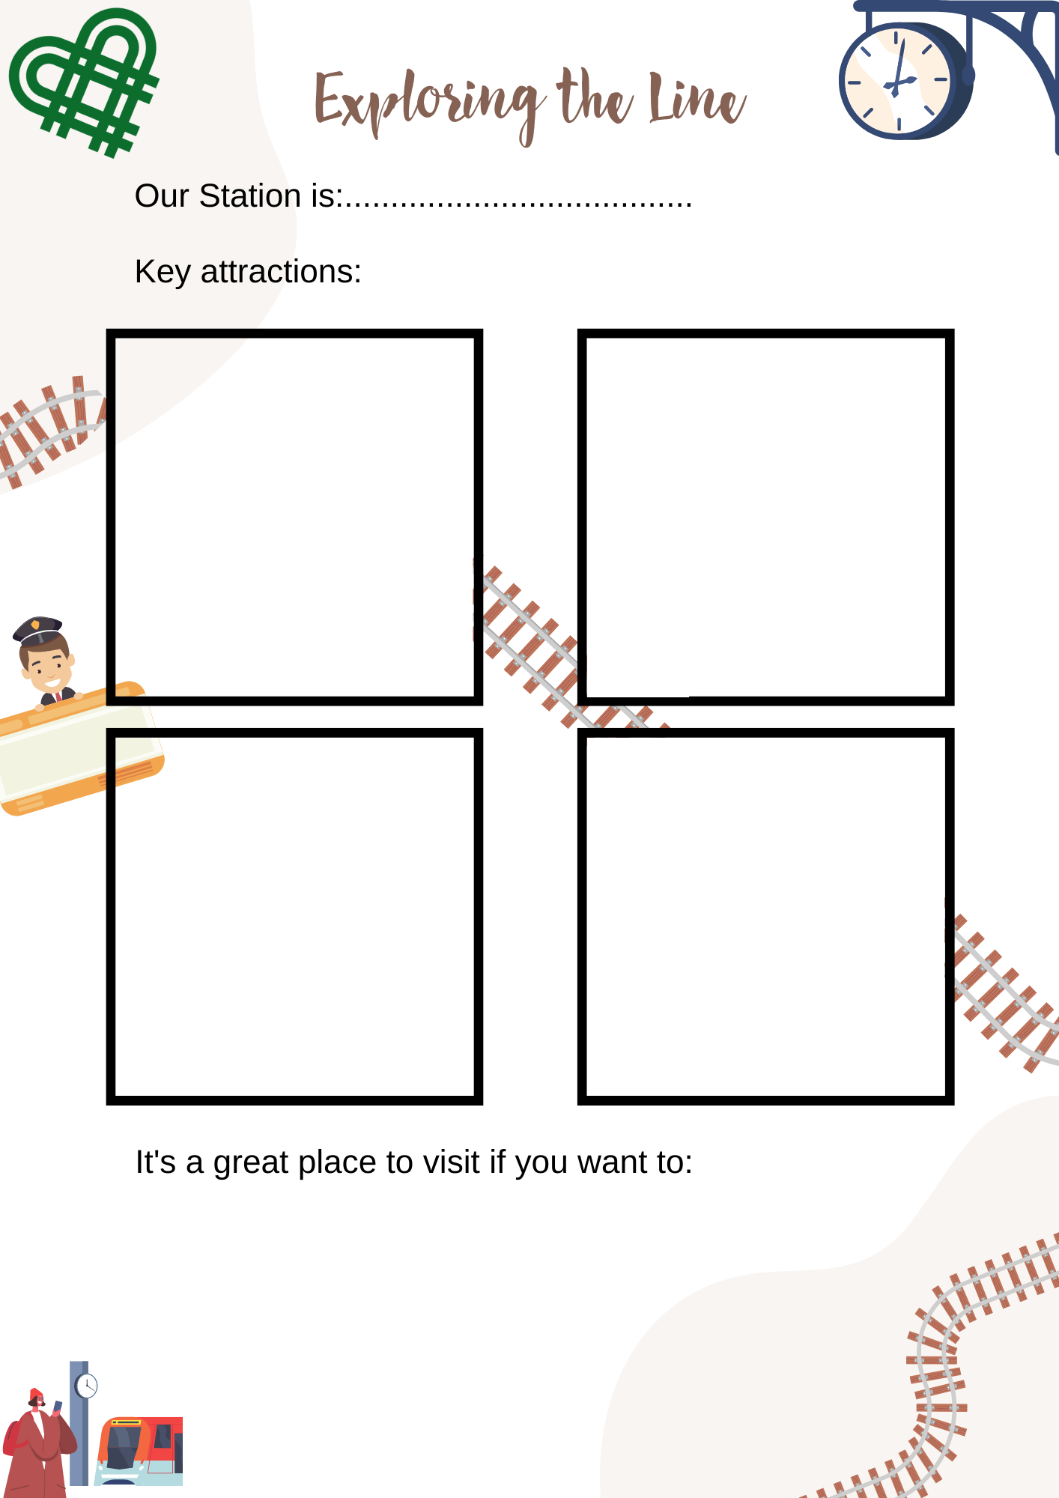
Group Activity
In groups, research one of the stations along the line (your teacher will assign you the station).
Fill in the ‘Exploring the Line’ worksheet.
Decide as a group who is going to feedback to the rest of the class about what you discovered about your station.
Notes:
Are there any similarities or connections to all the special places on the line?
Introduce idea that we want to think of a new name for the line.
Look at examples of other line names e.g. Shakespeare Line.

Slide 9
Have your say
Good Luck!

